Slide 1
COURSE NAME: DBMS
COURSE CODE:24AD2103
Topic: Transaction Management: Transaction processing issues, Transaction states

Slide 2



AIM OF THE SESSION
To familiarize students with the basic concept of Transaction Management
INSTRUCTIONAL OBJECTIVES
a) The concept of Transaction
b) Main Operations in a Transaction
c) Popular Examples of Transaction Processing
d) Transaction Processing Issues
e) Transaction States
LEARNING OUTCOMES
At the end of this session, you should be able to understand :
Transaction Processing Issues & States of Transaction Processing

Slide 3
TRANSACTION CONCEPTS
The transaction is a set of logically related operations done on a database.
A transaction is an action or series of actions.
Normally a transaction is performed by a single user to perform operations for accessing the contents of the database.
When a transaction is done on the database then the database will be updated.
These days we will come across various Transactions in our day to day life.

Slide 4
TRANSACTION CONCEPT
A successful transaction can change the database from one CONSISTENT STATE to another

Slide 5
TRANSACTION CONCEPT
For example, a transfer of funds from a checking account to a savings account looks like a single operation from the customer’s standpoint, but within the database system, however, it consists of several operations.
Usually, a transaction is initiated by a user program written in a high-level data-manipulation language (typically SQL), or programming language (for example, C++, or Java), with embedded database accesses in JDBC or ODBC.

Slide 6
TRANSCATION CONCEPT
1. Read your account balance
2. Deduct the amount from your balance
3. Write the remaining balance to your account
4. Read your friend’s account balance
5. Add the amount to his account balance
6. Write the new updated balance to his account
Note : The above SIX operations are logically related and forms as a single unit that constitutes a Transaction.

Slide 7
TRANSACTION-EXAMPLE-1
.
Suppose account A has a balance of Rs 1000 and wants to transfer Rs 800 from A's account to B's account, that has a balance, say 2000 . This small transaction contains several low-level tasks:
A's Account
Open_Account(A)
Old_Balance = A.balance
New_Balance = Old_Balance - 800
A.balance = New_Balance
Close_Account(A)
Note : Five Operations on A’s Account

Slide 8
TRANSACTION CONCEPTS
B's Account
Open_Account(B)
Old_Balance = B.balance
New_Balance = Old_Balance + 800
B.balance = New_Balance
Close_Account(B)
Note: Here FIVE Operations on B’s Account.

Slide 9
In Database Terminology, the above operations can be summarized as :
T_{i} : read(A);
A := A − 800;
write(A);
read(B);
B := B + 800;
write(B).
commit

Slide 10
How Transaction is being done inside the computer ?
In the previous example, initially the balance in the database for A’s account is Rs 1000 and it is present in the database means it is present in the Hard Disk.
Now to perform any arithmetic operation , first of all that A’s account has to be read for the available balance. For that read(A) operation is used. Remember this read operation is being performed on the Hard Disk(Database)
After read operation, to perform arithmetic operation of A=A-800, the data of Rs 1000 has to be brought into RAM memory.
After getting Rs 1000 into RAM, then the CPU will start its execution i.e performs subtraction of Rs 800 from Rs 1000.

Slide 11
How Transaction is being done inside the Computer ?
Now , to perform the transfer(addition) of Rs 800 to B’s account of Rs 2000, then this Rs 2000 of B has to be read and brought into RAM again.
After getting Rs 2000 of B’s balance into RAM, the CPU again starts performing the addition operation i.e B=B+800.
Remember all these operations are being done only inside RAM memory, but not in the Database(Hard Disk).
Finally , to save these changes into the Database finally, we have to use commit operation

Slide 12
Main Technical Operations used to perform Transaction
Transactions access data using TWO operations:
• read(A) which transfers the data item A from the database to a variable, also called A, in a buffer in main memory belonging to the transaction that executed the read operation.
•write(A) which transfers the value in the variable A in the main-memory buffer of the transaction
Apart from the above TWO, every transaction concludes with commit () operation to successfully save the updates

Slide 13
Don’t Confuse…..
A Single Operation CAN NOT be a Transaction but Transaction is a set of logically related operations.

Slide 14
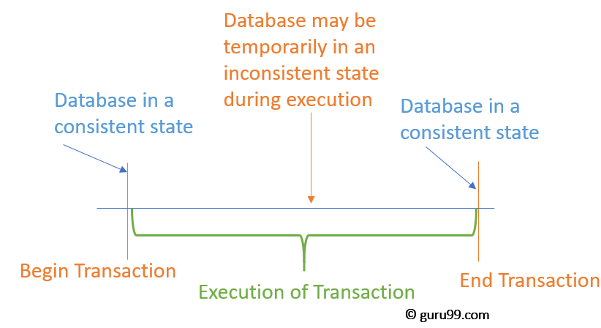
Transaction-Timing Diagram

Slide 15
Transaction-Example 2(E-Commerce)
Placing an Order in Flipkart/Amazon
Transaction Start
Selecting the item/product
Selecting a Payment Method(Net Banking/Gpay/Pay Later etc.,)
If it is Net Banking, then Select the Bank
Enter the User ID & Password on that Bank Net Banking Portal
Approve the Amount
Enter the High Security Password
Check the amount Payment is Successful or not
Return to Merchant Website
Transaction Completed

Slide 16
Example 3-Transaction to be performed to withdraw cash from an ATM
Consider the following example for transaction operations as follows.
Transaction Start.
Insert your ATM card.
Select language for your transaction.
Select Savings Account option.
Enter the amount you want to withdraw.
Enter your secret PIN.
Wait for some time for processing.
Collect your Cash.
Transaction Completed.

Slide 17
Popular Examples of Transaction Processing
Automated Teller Machines(ATMs)
Credit Card Authorizations
Online Bill Payments
Self-Checkout stations at Grocery Stores
Trading of Stocks over the Internet and
Various other forms of Electronic Commerce.

Slide 18
Transaction Processing Issues
Failure of Operations in the middle of a transaction.
Can be due to power failure, system crash etc. This is a serious problem that can leave database in an inconsistent state.
Assume that transaction fail after entering the PIN number in ATM , then the account statement shows that the amount is deducted from but we wont receive the cash from the machine outlet or our friend will not receive it. This is called as inconsistent database.

Slide 19
Transaction Processing Issues
Ensuring Data Consistency before and after the transaction
For example, for amount transfer transaction from Account A to Account B, then the total should be the same before and after the transaction.
Handling Concurrent Transactions
Once a transaction completes successfully, the updates should be reflected permanently, even during power/network failures etc.,

Slide 20
Concurrent Execution of Transactions
In a multi-user system, multiple users can access and use the same database at one time, which is known as the concurrent execution of the database.
It means that the same database is executed simultaneously on a multi-user system by different users.
While working on the database transactions, there occurs the requirement of using the database by multiple users for performing different operations, and in that case, concurrent execution of the database is performed.

Slide 21
Concurrent Execution of Transactions
The thing is that the simultaneous execution that is performed should be done in an interleaved manner, and no operation should affect the other executing operations, thus maintaining the consistency of the database.
Thus, on making the concurrent execution of the transaction operations, there occur several challenging problems that need to be solved

Slide 22
Concurrent Execution of Transactions
In a database transaction, the two main operations are READ and WRITE operations.
So, there is a need to manage these two operations in the concurrent execution of the transactions as if these operations are not performed in an interleaved manner, and the data may become inconsistent

Slide 23
Transaction States
A transaction goes through many different states throughout its life cycle.
These states are called as transaction states.
Transaction states are as follows-
Active state
Partially committed state
Committed state
Failed state
Aborted state
Terminated stat

Slide 24
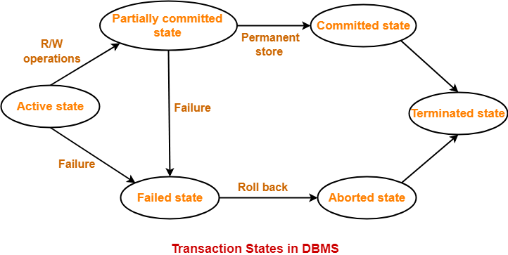
Transaction States

Slide 25
Transaction States
1. Active State-
This is the first state in the life cycle of a transaction.
A transaction is called in an active state as long as its instructions are getting executed.
All the changes made by the transaction now are stored in the buffer in main memory.
2. Partially Committed State-
After the last instruction of transaction has executed, it enters into a partially committed state.
After entering this state, the transaction is considered to be partially committed.
It is not considered fully committed because all the changes made by the transaction are still stored in the buffer in main memory.

Slide 26
Transaction States
3. Committed State-
After all the changes made by the transaction have been successfully stored into the database, it enters into a committed state.
Now, the transaction is considered to be fully committed.
NOTE-
After a transaction has entered the committed state, it is not possible to roll back the transaction.
In other words, it is not possible to undo the changes that has been made by the transaction.
This is because the system is updated into a new consistent state.
The only way to undo the changes is by carrying out another transaction called as compensating transaction that performs the reverse operations.

Slide 27
Transaction States
4. Failed State-
When a transaction is getting executed in the active state or partially committed state and some failure occurs due to which it becomes impossible to continue the execution, it enters into a failed state.
5. Aborted State-
After the transaction has failed and entered into a failed state, all the changes made by it have to be undone.
To undo the changes made by the transaction, it becomes necessary to roll back the transaction.
After the transaction has rolled back completely, it enters into an aborted state.

Slide 28
Transaction States
6.Terminated State
This is the last state in the life cycle of a transaction.
After entering the committed state or aborted state, the transaction finally enters into a terminated state where its life cycle finally comes to an end.

Slide 29
ALM: Group Discussion
Is getting a Balance Enquiry/Mini Statement Slip from an ATM Machine a Transaction or Not ? And Why ? Discuss

Slide 30
Summary of Session
Collections of operations that form a single logical unit of work
The transaction is a set of logically related operation. It contains a group of tasks.
A transaction is an action or series of actions.
A transaction is performed by a single user to perform operations for accessing the contents of the database.
Every Transaction starts with read ( ) operation and ends with write( ) Operation, followed by commit operation.
Transaction processing is designed to maintain database integrity (the consistency of related data items) in a known, consistent state.

Slide 31
SELF-ASSESSMENT QUESTIONS
A True Transaction updates the Database
True
False
Can’t Say
None of the Above
2. At the end of every transaction, every transaction concludes with
Read ( ) Operation
Commit ( ) Operation
Roll Back ( ) Operation
None of the Above

Slide 32
TERMINAL QUESTIONS
Discuss about the Concept of Transaction Processing
List out the Steps of Operations in a Transaction Processing
Why a simple Operation on a database can not be a Transaction ?
Discuss about various Issues during a Transaction ?
Draw the diagram of Transaction States and Explain ?

Slide 33
REFERENCES FOR FURTHER LEARNING OF THE SESSION
Reference Books:
1. "Database Management Systems" by Raghu Ramakrishnan and Johannes Gehrke - This is a comprehensive textbook that covers both theoretical and practical aspects of DBMS, including data modeling, relational algebra, SQL, query optimization, transaction management, and distributed databases.
2. "Fundamentals of Database Systems" by Ramez Elmasri and Shamkant Navathe - This is another popular textbook that covers the fundamental concepts of DBMS, including database design, normalization, SQL programming, transaction management, and concurrency control.
Sites and Web links:
https://www.geeksforgeeks.org/shadow-paging-dbms/
https://www.tutorialspoint.com/what-is-shadow-paging-in-dbms
https://whatisdbms.com/shadow-paging-in-dbms/

Slide 34

THANK YOU
Team – DBMS

